Slide 1
Face matching technology based on comparison of images’ similarity
01
05
基于图片相似度比较的人脸匹配技术
Speaker：Zhang Xudong
2023.04.13

Slide 2
CONTEN TS
Application and Significance
Classical algorithm of comparison of images’ similarity
Improvement
Difficulty

Slide 3
Application and significance
03
05
01

Slide 4
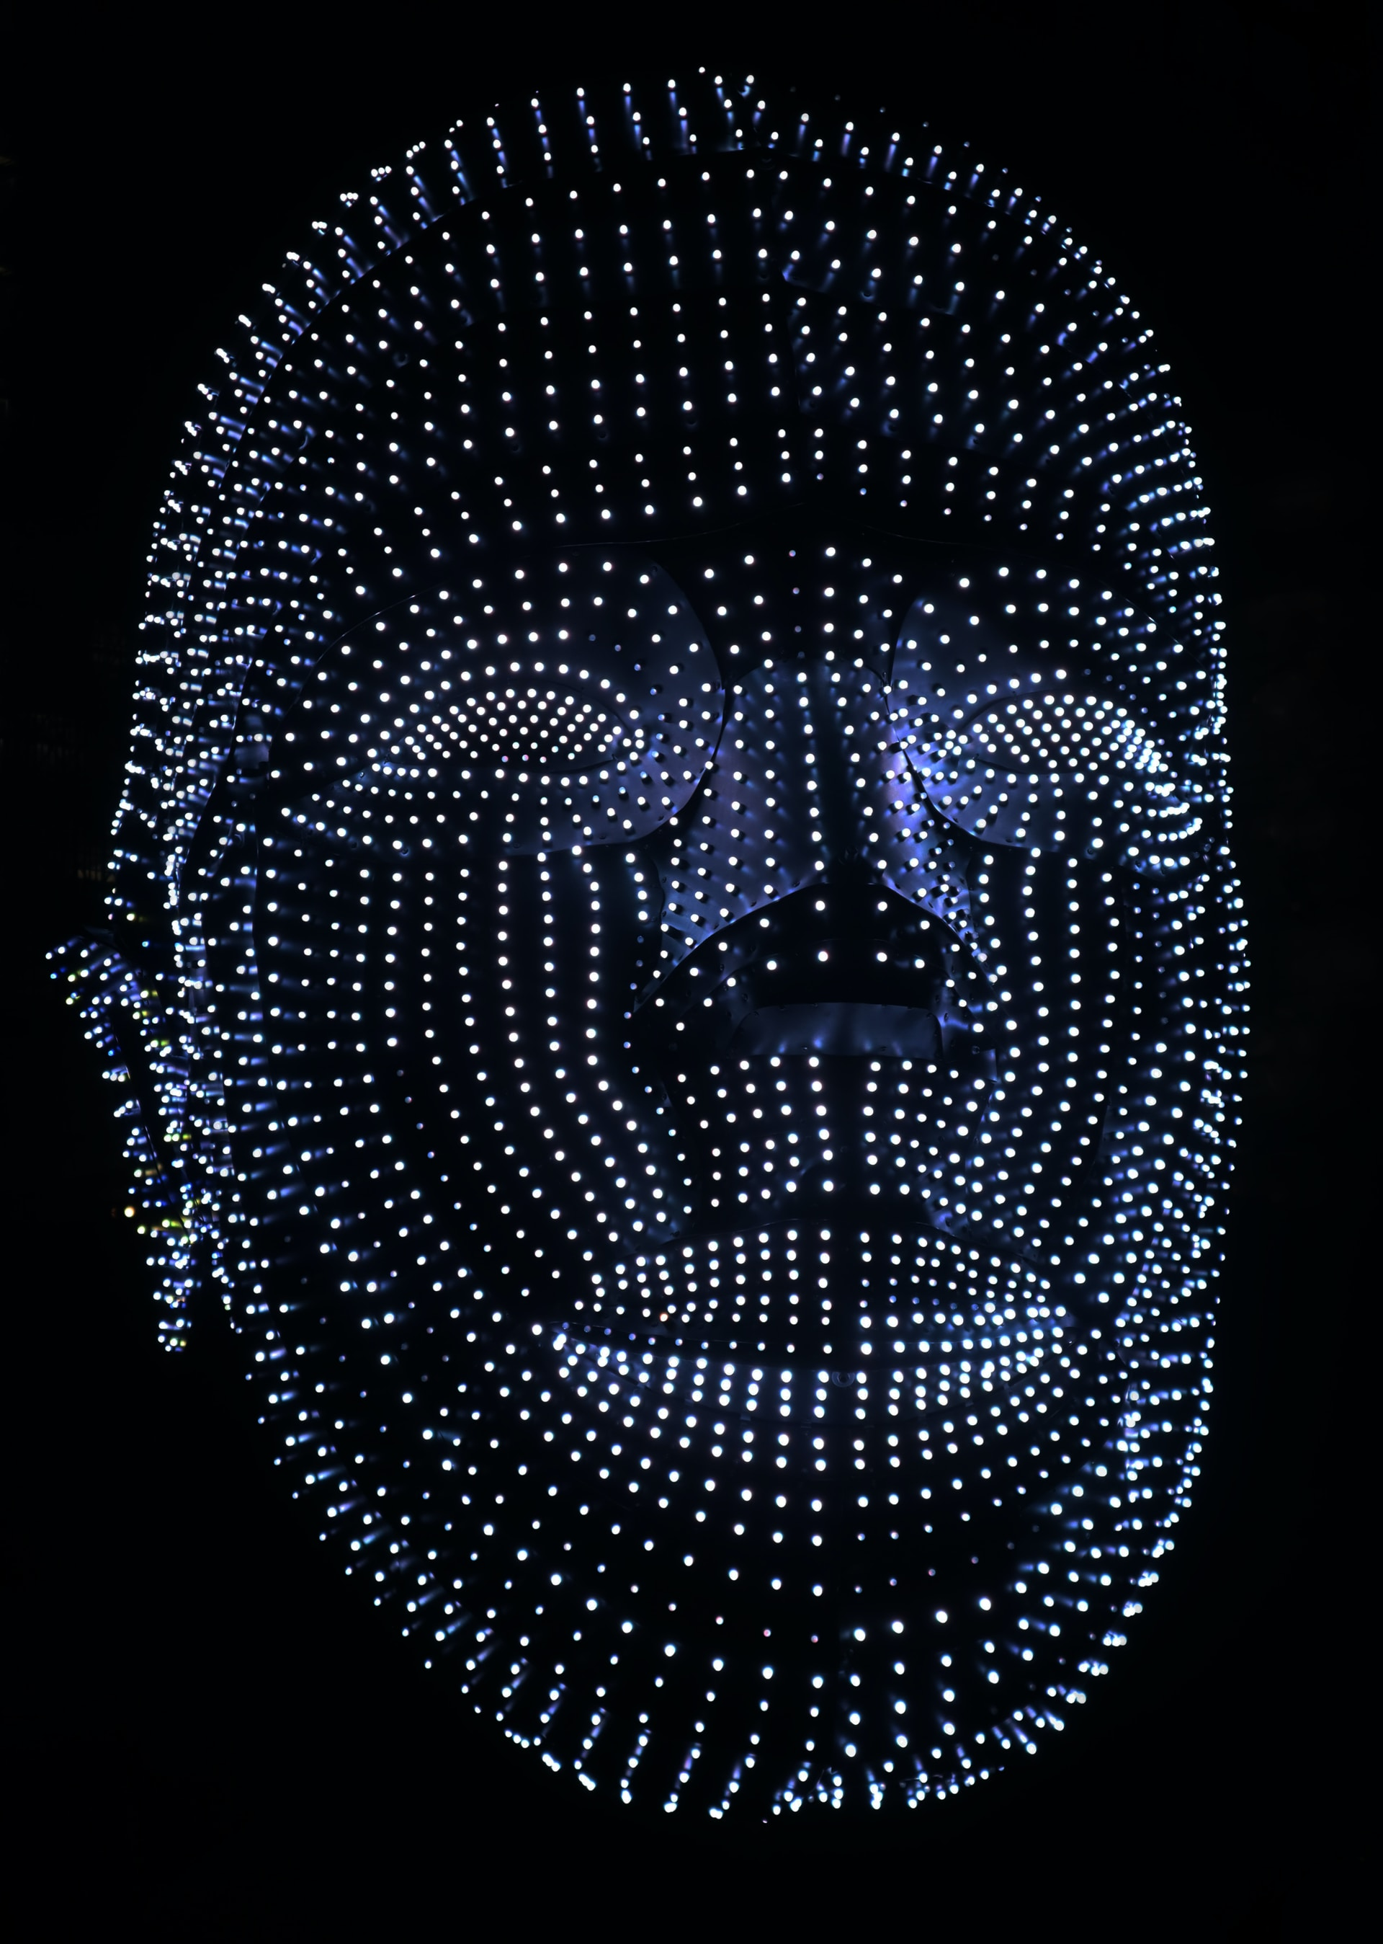
Application and significance
Search for
missing
persons
Search for missing persons
Smart
device
unlock
Face unlocking function
Face recognition deposit and withdrawal, electronic bank remote account opening, online payment network
Financial
transaction
Intelligent
security
Public security inspection, online fugitives, household registration survey, certificate inspection
Public
transport
Education
field
Aviation security check
Attendance of class

Slide 5
Classical algorithm of comparison of images’ similarity
03
05
02

Slide 6

Classical algorithm
Average hashing
Differential hashing
Perceptual hash
Three histogram
Single channel histogram

Slide 7
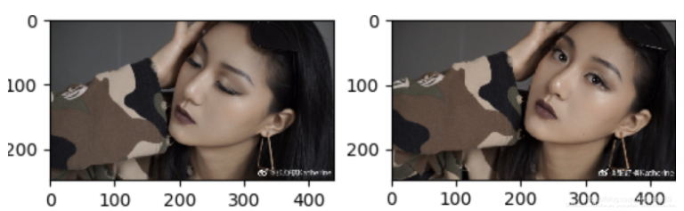

performance

Slide 8
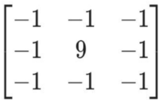
Classical processing flow
锐化卷积算子
Sharpening convolution
Calculate targeted
value
Difference calculation
disadvantage
Due to noise, sharpening convolution and similarity comparison of images directly will make the error rate of results relatively high.

Slide 9
Improvement
03
05
03

Slide 10

Process flow
Step 01
Step 02
Step 03
Step 04
Step 05
filtering
Image segment
Feature extraction
value calculation
difference calculation
Bilateral filtering
Wavelet transform
Histogram of Oriented Gradient
Perceptual hash
Hamming distance

Slide 11
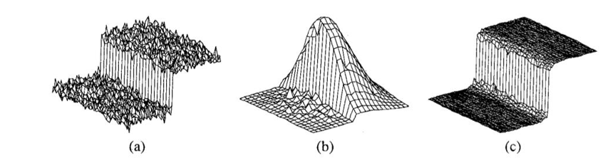




Bilateral filtering

Slide 12
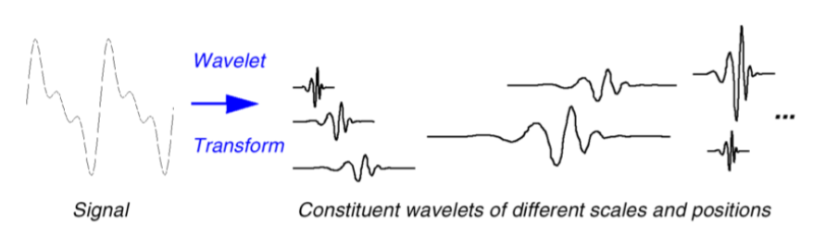


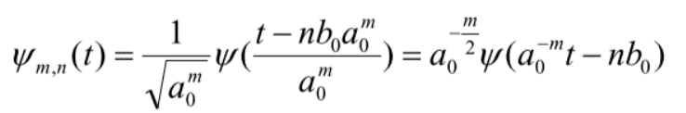
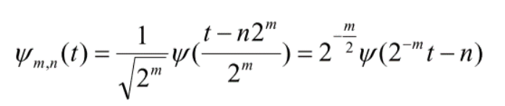
Wavelet transform

Slide 13
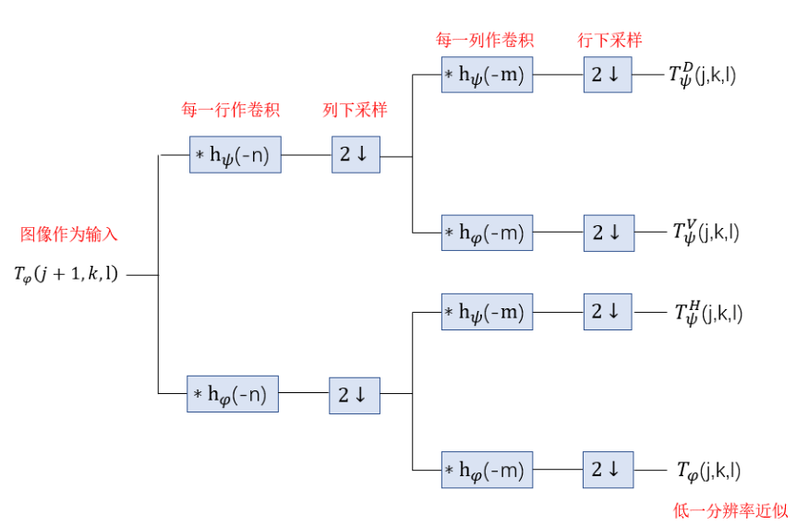
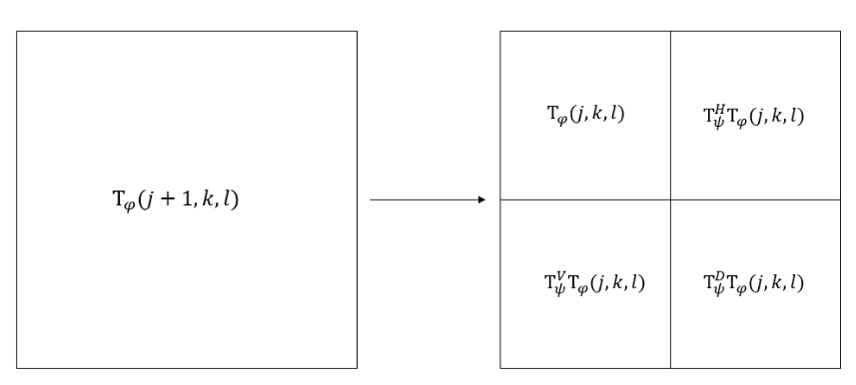
Wavelet transform

Slide 14


Wavelet transform

Slide 15
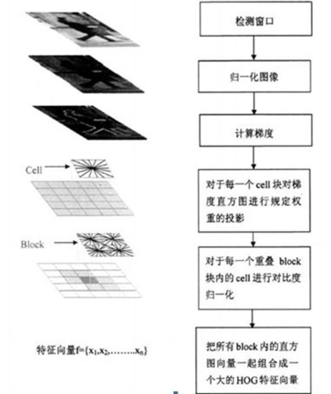
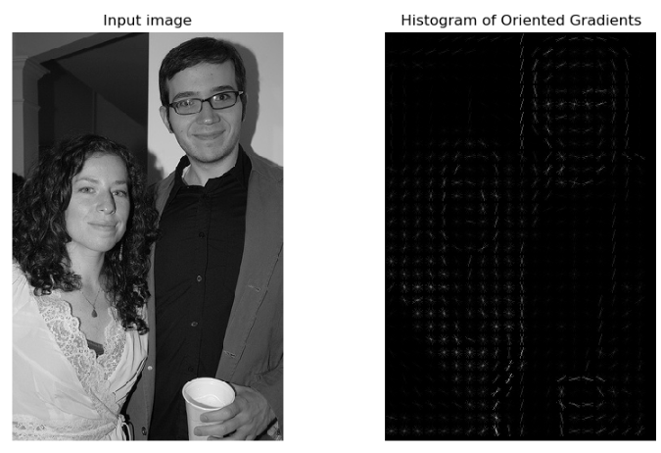
Histogram of Oriented Gradient

Slide 16
Perceptual hash
advantage
After the image is rotated or scaled, the effect is even better.
Step1
Step2
Step3
Step4
resize.
graying
Calculate DCT matrix
Resize DCT matrix.
Calculate average value of DCT matrix
Calculate hash value

Slide 17
difficulty
03
05
04

Slide 18

difficulty
Template image
The data set of result test
Choosing a template image with low noise is beneficial to face matching results
search for images of the same face
With relative noise

Slide 19
Thanks
05
05

